Slide 1


IPL Data Analysis Report
Amal K B
July 1 Batch

Slide 2

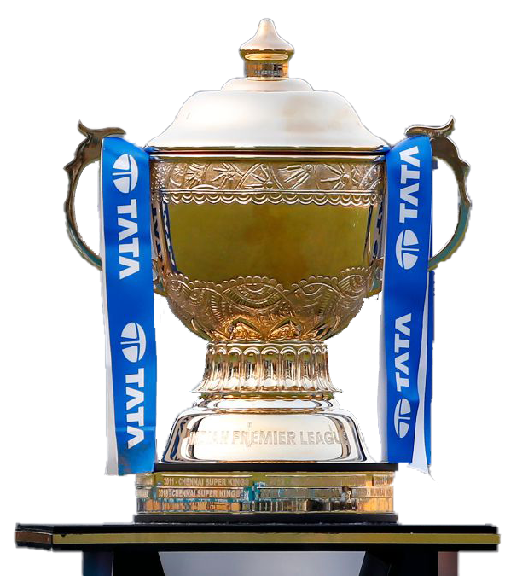
Introduction
The IPL season runs from March to May. Ten teams battle it out in Twenty20 matches across India.Since its inception in 2008, the IPL has grown into a global sporting spectacle, attracting top players from around the world. Organized by the Board of Control for Cricket in India (BCCI), the league features franchise teams representing different cities, each competing for the coveted IPL trophy.

Slide 3

IPL Overview
Business
Objective
Key
Insights
Reccommendations
Conclusion.

Slide 4



IPL Overview
Location
Matches hosted across major cricket stadiums in India.
Teams
Ten city-based teams compete fiercely.
Format
Twenty20 cricket, offering fast-paced, exciting matches.
Schedule
Typically spans over two months, April to May.

Slide 5
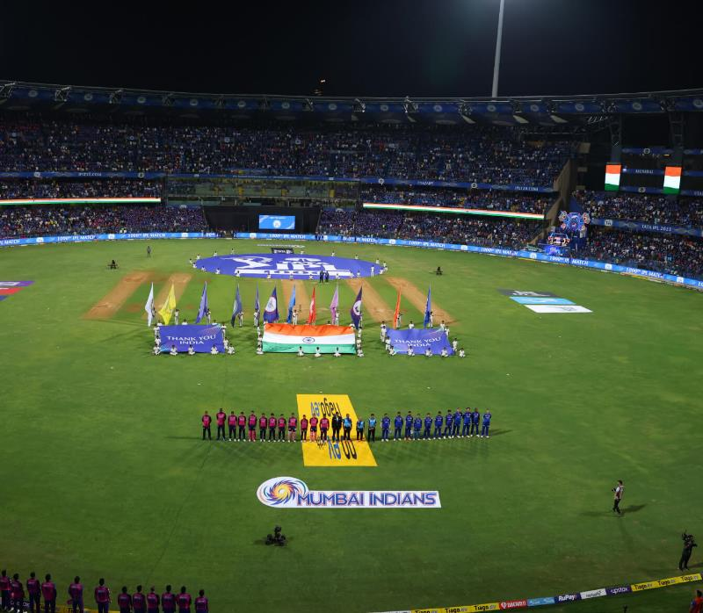
Objective
This project analyzes Indian Premier League (IPL) data—matches and deliveries—to uncover performance patterns, key success factors, and trends over seasons. Using Power BI, we built an interactive dashboard that enables stakeholders (team managers, analysts, broadcasters, and fans) to explore:
Top teams and players
Impact of toss decisions and venues
Performance evolution over time

Slide 6











Team Playing
Chennai Super Kings
Gujarat Titans
Delhi Capitals
Kolkata Knight Riders
Lucknow Super Giants
Punjab Kings
Mumbai Indians
Rajasthan Royals
Sunrisers Hyderabad
Royal Challengers Bengaluru
Rising Pune Supergiants

Slide 7
Narendra Modi Stadium (Ahmedabad)
Capacity: 132,000
Wankhede Stadium (Mumbai)
Capacity: 33,108
Dy Patil Stadium (Navi Mumbai)
Capacity: 55,000
Edan Gardens (Kolkata) Capacity: 68,000
M A Chidambaram Stadium (Chennai) Capacity: 38,200
M Chinnaswamy Stadium (Bengaluru)
Capacity: 33,800\
IPL Best Venue
Arun Jaitley Stadium
(Delhi)
Capacity: 35,200
Edan Gardens
(Kolkata)
Capacity: 68,000
Narendra Modi Stadium
(Ahmedabad)
Capacity: 132,000
M Chinnaswamy Stadium
(Bengaluru)
Capacity: 33,800
Wankhede Stadium
(Mumbai)
Capacity: 35,200
Dy Patil Stadium
(Navi Mumbai)
Capacity: 35,200
M A Chidambaram Stadium
(Chennai)
Capacity: 38,200

Slide 8




Best Team and Players
Highest sucess rate - Chennai
Harbhajan singh - highest wickets
KD Karthik - best fielder
Best Bowling - Kolkatta
Gambir - Most boundaries
M Chinnaswamy Stadium
Mumbai Indians - Most won
City - Mumbai
SK Raina - Highest score
CH Gayle - most player of match and sixes

Slide 9
Insights
Teams winning the toss and choosing to field have a slightly higher win rate.
Certain venues (e.g., Wankhede, Chinnaswamy) favor high-scoring matches—ideal for aggressive batting lineups.
Players with consistent boundary-hitting ability (e.g., top 5 six-hitters) show strong correlation with match-winning performances.
Bowlers with high dot-ball percentages contribute significantly to match control, even if wicket counts are low.
Mumbai Indians has most wins and hit boundaries also given most extra runs while bowling(needed training).
Analysed best venue for each team.
Best season for matches are summer season.
May and April got most matches.
Win by wickets is greater than win by runs.
It rare to have tie and only 3 matches got cancelled.
Kumar and Malinga needs more training as they given most wide runs.
Doshi and Ladda got most ducks.
Gayle as batsmen and pathan as bowler got most player of match award.

Slide 10
Recommendations
Use venue-specific performance data to guide team composition and strategy.
Prioritize players with multi-season consistency during auctions.
Leverage toss decision analytics to refine match-day tactics.
Highlight close matches and top performers in fan engagement campaigns.
Bat First Advantage: Teams batting first win ~57% of matches—consider chasing only under favorable conditions (e.g., dew-free venues).
Stable Opening Partnerships: Top teams consistently post 50+ powerplay runs, correlating with a 20% higher win rate.
Death-Over Specialists: Bowlers with economy <8 in overs 16–20 are 30% more likely to belong to title-winning squads.
Venue Selection Strategy: Certain stadiums (e.g., Chennai) favor spin—teams should bid accordingly and adjust playing XI.
Fielding Excellence: Teams in top four have 15% more catches/run-outs per match—invest in fielding coaches and drills.

Slide 11
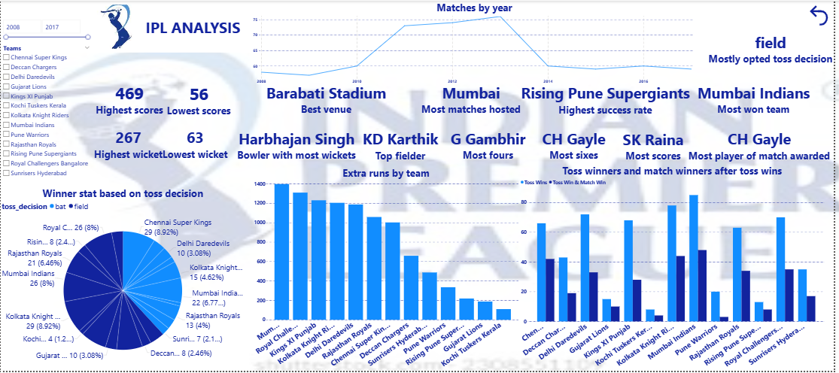
Dashboard

Slide 12
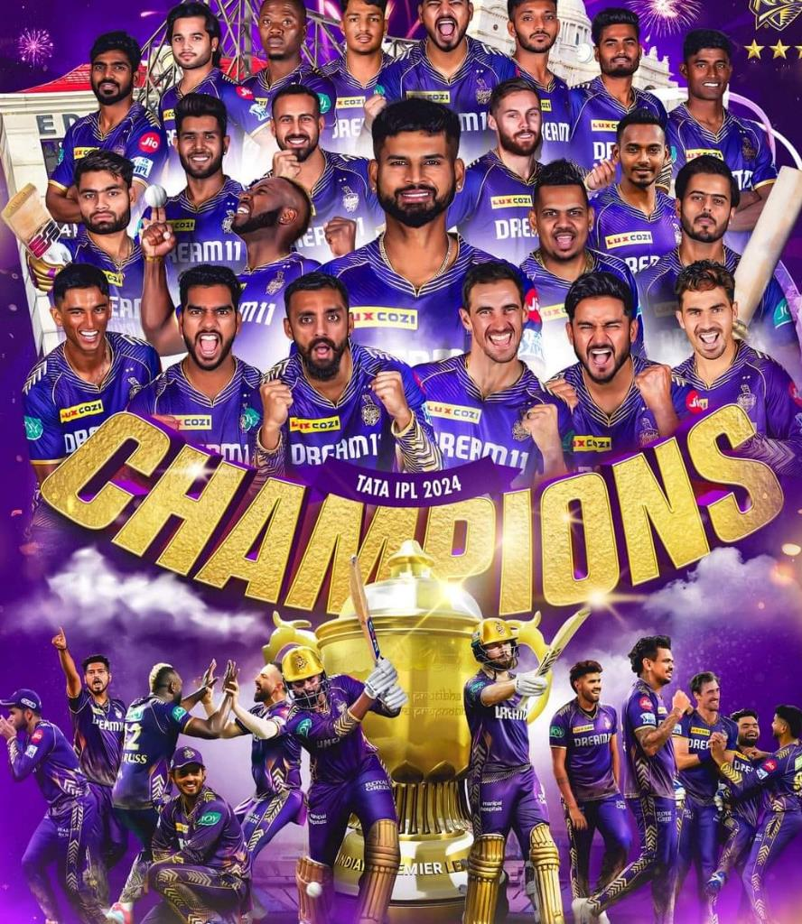

Conclusion
This IPL analytics dashboard delivers actionable insights into team strategies, player performance, and match conditions. By leveraging interactive visualizations in Power BI/Tableau, stakeholders can make informed decisions on squad composition, match tactics, auction strategies, and broadcasting narratives—ultimately driving competitive advantage and fan engagement.

Slide 13
Thank You!
Open for questions?

